Slide 1
Nurses Leading the Way in Translating Pain Science in Sickle Cell Disease
The Foundation for Sickle Cell Disease Research 30 March 2023
2nd Annual Nursing Symposium
Keesha Roach, PhD , RN
Assistant Professor
University of Tennessee Health Science Center

Slide 2
Disclosures
Keesha (Powell) Roach – No conflicts of interest to disclose

Slide 3
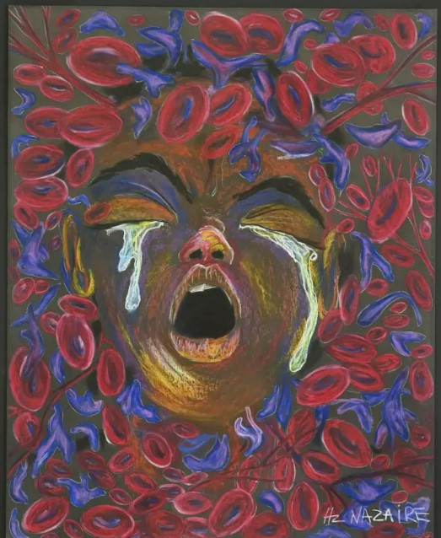
This Presentation will focus on pain in sickle cell disease and review how key discoveries in SCD research over the years have been translated to change how to treat the disease and the whole person.
Ten Redefined Art by Hertz Nazaire

Slide 4
Objectives
Describe sickle cell disease (SCD).
Describe what is known about pain in SCD and possible targets in the treatment of SCD pain.
Describe the challenges treating pain in SCD.

Slide 5
What is Sickle Cell Disease?

Slide 6
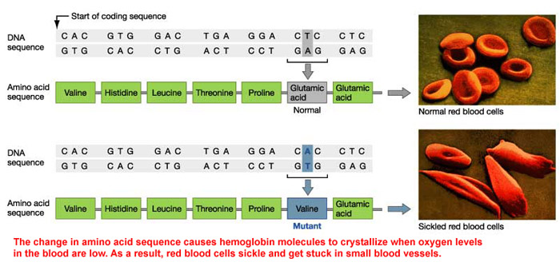
A point mutation (rs334)
Notes:
SCD is an autosomal recessive group of inherited blood-related disorders involving hemoglobin, caused by a missense point mutation in the 6th codon on chromosome 11 of the B-Globin chain of hemoglobin, where the DNA nucleotide adenine “A” replaces “T” thymine, thus causing an amino acid change from glutamine to valine, resulting in crystallization of hemoglobin molecules when oxygen levels in the blood are low, resulting in sickle hemoglobin (HbS).
In many sub-Saharian African countries, pain and sickle cell disease (SCD) are so intimately intertwined, that there are tribal words used to describe the pain for the disease that are onomatopoeic and have been spoken hundreds of years before Herrick described SCD in the Western literature.

Slide 7
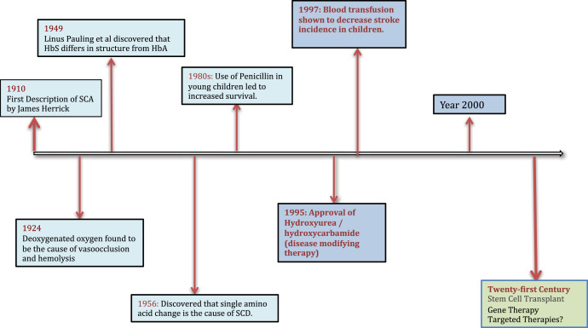
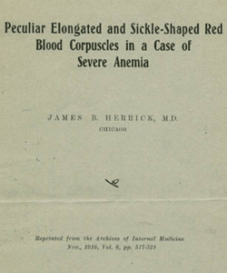
Milestones of SCD
Notes:
SCD is the first molecular disease. This was the first published paper on sickle cell disease and describes the first patient to be identified with sickle cell disease here in the US, which was in Chicago .
1910 - James Herrick described first patient
1920’s - Lemuel Diggs suggests that pain in is due to sickle cells clogging small blood vessels
1949 – Linus Pauling demonstrated that the disease originates from a mutated Hb
1956- Vernon Ingram and J.A Hunt discovered that a single amino acid substitution is responsible for SCD

Slide 8
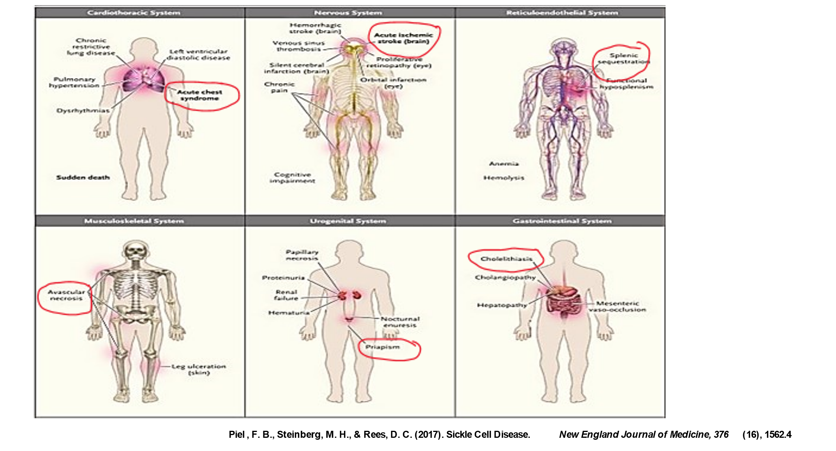
Multi-System Disorder
SCD is a multi-system disorder. Every organ system in the body is impacted from an early age. People with SCD are plagued with stroke, blindness, acute chest syndrome, heart attacks, renal failure, leg ulcers, avascular necrosis, liver damage, splenic sequestration, and chronic pain conditions.
Notes:
A Vaso-occlusive crisis can occur anywhere blood flows, making this disease a multi-system disorder. Every organ system in the body is impacted from an early age. People with SCD may be plagued with stroke, blindness, acute chest syndrome, heart attacks, renal failure, leg ulcers, avascular necrosis, liver damage, splenic sequestration, and pain conditions that often requires treatment with opioids, especially in adults.

Slide 9
Current Therapies: Disease Modifying Treatments
Stem Cell Transplant
Gene Therapy
Pharmacologic
Notes:
Stem Cell Transplant
Also referred to as Bone marrow transplantation (BMT) is currently the only known cure for sickle cell disease.
Gene Therapy
Gene therapy is a potentially curative or highly disease- modifying option for removing complications of the disease. We are beginning to understand the different types of gene therapy that are in use, the differences in their end points, and their potential risks and benefits will be key to optimizing the long-term use of this therapy.
These therapies do not cure pain. Patients still get chronic pain post transplant
Pharmacologic
Hydroxy Urea

Slide 10
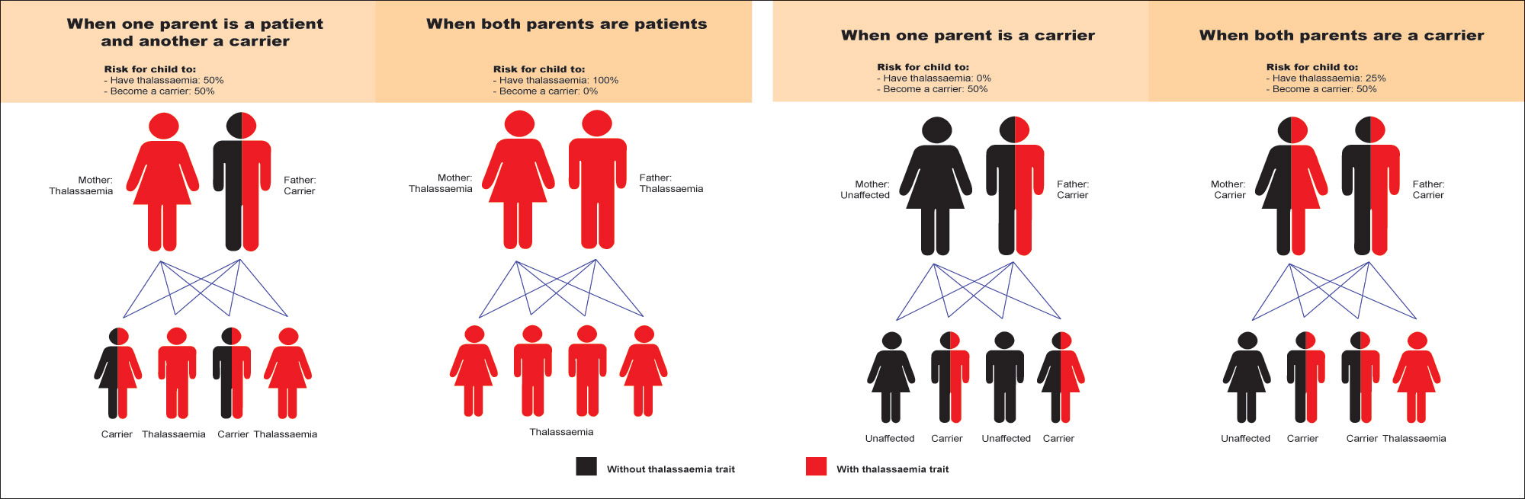
Risk of inheritance
Notes:
The risk of a child inheriting sickle cell disease or sickle cell trait is as follows:
-If both parents have sickle cell trait (each has one normal and one sickle cell gene), the child has a 50% chance of inheriting sickle cell trait, 25% chance of inheriting sickle cell disease, and 25% chance of inheriting two normal genes.
-If one parent has sickle cell trait and the other parent has two normal hemoglobin genes, the child has a 50% chance of inheriting sickle cell trait and a 50% of inheriting neither the trait nor the disease.
-If one parent has sickle cell disease and the other parent has sickle cell trait, the child has a 50% chance of inheriting sickle cell trait and a 50% chance of inheriting sickle cell disease.
-If one parent has sickle cell disease and the other parent has two normal hemoglobin genes, the child has a 100% chance of inheriting sickle cell trait, but not the disease.
-If both parents have sickle cell disease, the child has a 100% chance of inheriting the disease.

Slide 11
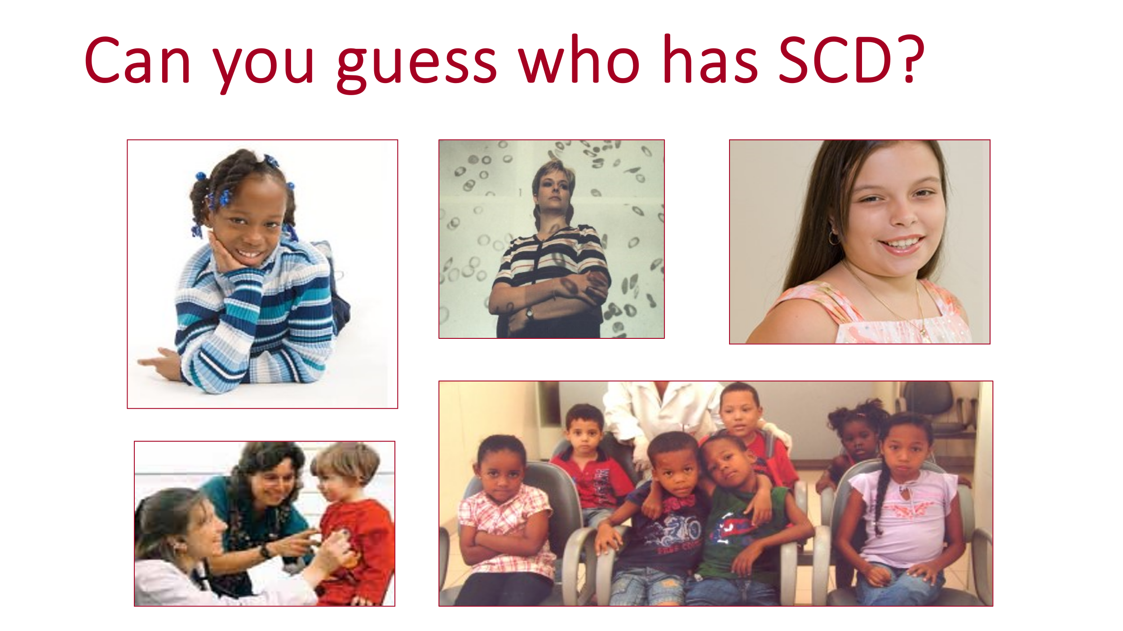
Notes:
(used with permission – Artangela Henry)

Slide 12


Slide 13
Epidemiology

Slide 14
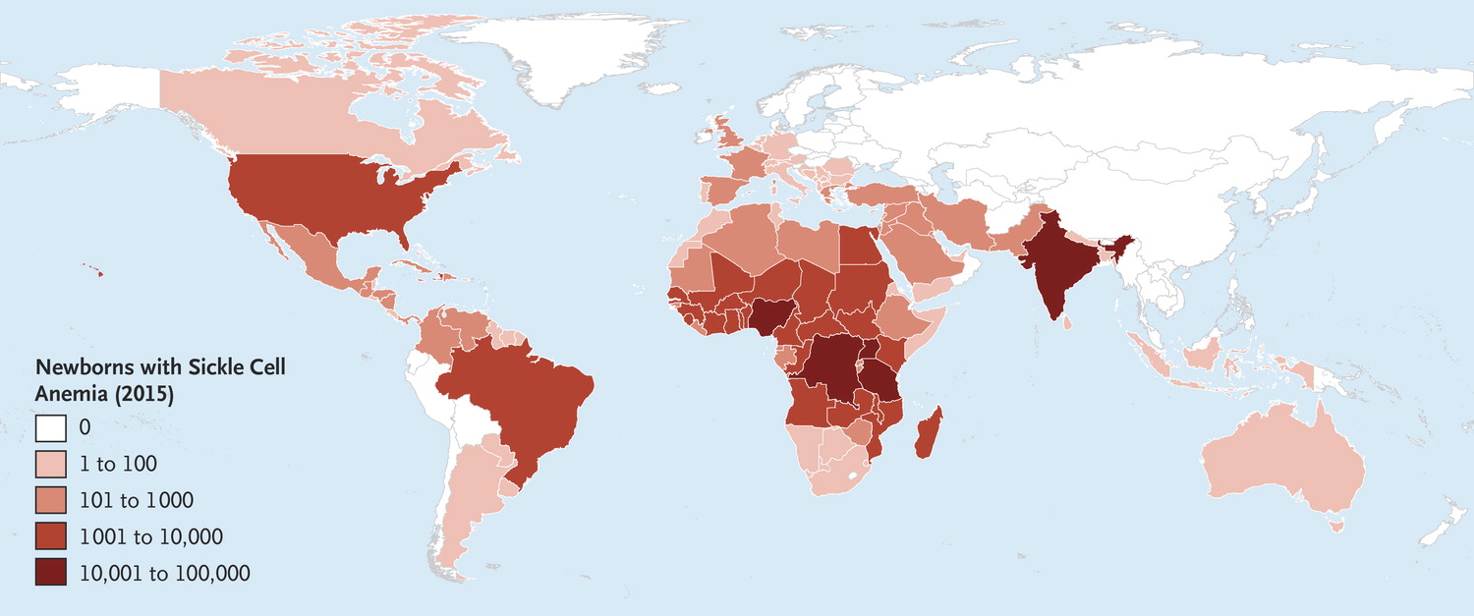
300,000 Newborns each year
Piel, F. B., Steinberg, M. H., & Rees, D. C. (2017). Sickle Cell Disease. New England Journal of Medicine, 376(16), 1562.
Notes:
SCD is the most common hemoglobinopathy and is a global health issue. It affects approximately 300,000 newborns each year in India, the Middle East and nearly 70% in sub-Saharan Africa, and 100,000 Americans. In the US, SCD disproportionately impacts Black and Hispanic Americans.
The Highest incidence of SCD is in Nigeria, the Democratic Republic of the Congo, and India.
In Africa, with has 75% of the global sickle burden, >50% of affected children die before they reach their 5th birthday.
Primarily due to infections – pneumococcal and other bacteria, and malaria 5% of all under-five deaths in Africa and up to 9% in West Africa are related to SCD.

Slide 15
Epidemiology (USA)
SCD occurs among about 1 out of every 365 Black or African-American births.
SCD occurs among about 1 out of every 16,300 Hispanic-American births.
1 out of every 65,000 White-American births
Notes:
SCD occurs among about 1 out of every 365 Black or African-American births.
SCD occurs among about 1 out of every 16,300 Hispanic-American births.
1 out of every 65,000 White-American births

Slide 16
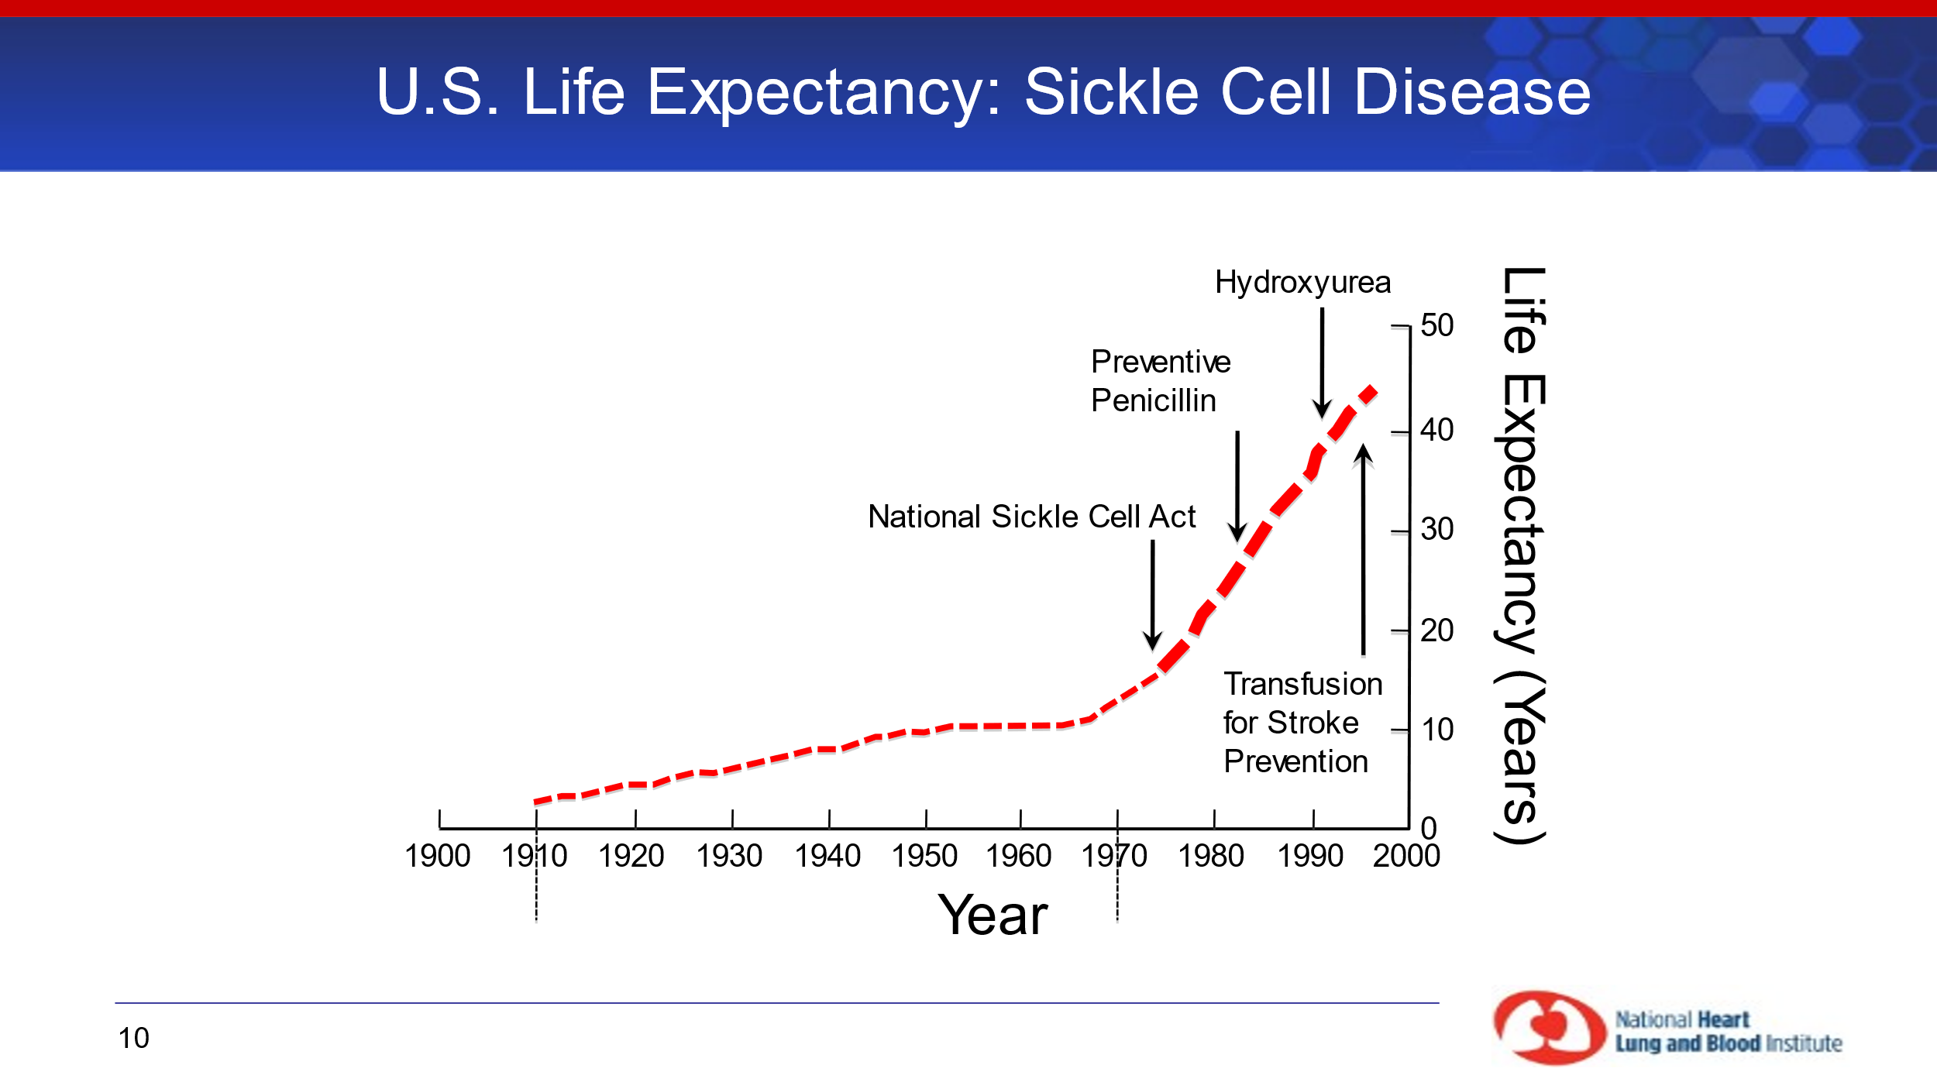
Notes:
Survival has increased dramatically in sickle cell disease in the US since its first description by James Herrick in 1910. SCD-related death among Black or African-American children <4 years of age fell by 42% from 1999 through 2002.
The first major improvement in survival came with the recognition that septicemia was a major cause of death in young children with sickle cell disease, often before they had been diagnosed, since characteristic clinical symptoms are often not evident until the second year of life. Early, aggressive treatment with antibiotics, and use of blood transfusions for acute chest syndrome and the introduction the pneumococcal vaccine in 2000, greatly improved survival of sickle cell patients into adulthood. Major morbidity remains, however, especially from stroke and pain.
Once they reach adulthood, patients with sickle cell disease suffer from chronic organ damage due to repeated sickling and vascular damage. Death is usually do to chronic organ failure: lung, kidneys, and cardiac failure are the primary causes. Recent work has shown that chronic vascular damage is due both to adherent erythrocytes and hemolysis. Intravascular hemolysis interferes with the NO vasodilating system in two ways: (1) releases RBC arginase into the plasma, lowering the synthesis of NO; (2) increases plasma free Hb, which directly scavenges endothelial-derived NO. Early death is still the rule in resource-poor environments.

Slide 17
Pain in SCD

Slide 18
Pain
The Hallmark symptom of SCD is intense pain that can start during infancy and increase in severity throughout the life span, leading to hospitalization, poor quality of life, increased healthcare cost and early mortality.
Notes:
The Hallmark symptom of SCD is intense pain that can start during infancy and increase in severity throughout the life span, leading to hospitalization, poor quality of life, increased of healthcare cost and early mortality.
Pain in SCD is different from other pain states. The pain may begin in infancy. These patients may suffer from both chronic and acute pain, and live with fear and anxiety because the location, frequency, duration and severity are unpredictable.

Slide 19
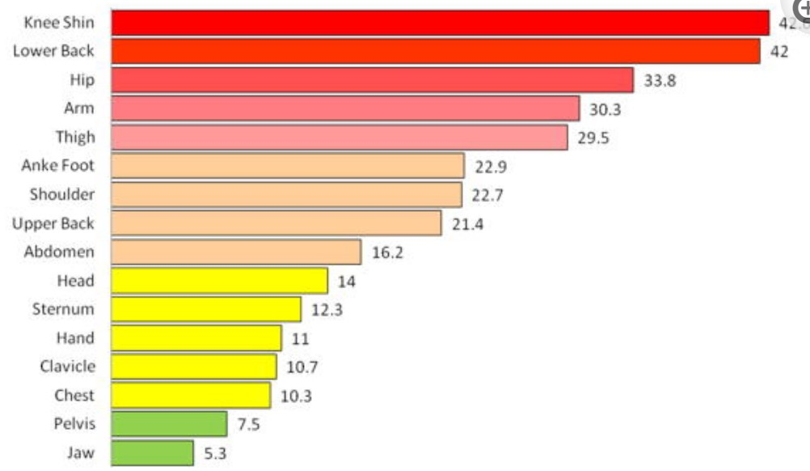
Pain: Body site and pain days
McClish DK, Smith WR, et. al., Pain site frequency and location in sickle cell disease: the PiSCES project. Pain. 2009
Notes:
As described by Wally Smith et. al, in his PiSCES Project, this slide represents the most common pain sites which hurt an average of more than one third of pain days in adults living with sickle cell disease.

Slide 20
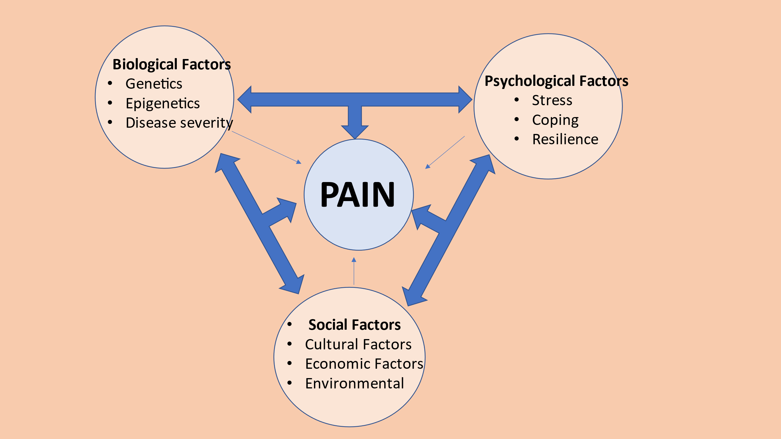
Factors that Contribute to Pain
Notes:
Factors that Contribute to Pain
In Sickle cell disease there are multiple factors that contribute to the pain experience. Multiple biopsychosocial factors known to contribute to other pain conditions have not been studied in SCD. Multidisciplinary pain research will aide in opening that path.
Biological Factors
Genetics
Epigenetics
Disease severity
Psychological Factors
Stress
Coping
Resilience
Social Factors
Cultural factors
Economic Factors
Environmental Factors
In Sickle cell disease there are multiple factors that contribute to the pain experience. Multiple biopsychosocial factors known to contribute to other pain conditions have not been studied in SCD. Multidisciplinary pain research will aide in opening that path.
Biological Factors
Genetics
Epigenetics
Disease severity

Slide 21
Notes:
Factors that Contribute to Pain
In Sickle cell disease there are multiple factors that contribute to the pain experience. Multiple biopsychosocial factors known to contribute to other pain conditions have not been studied in SCD. Multidisciplinary pain research will aide in opening that path.
Biological Factors
Genetics
Epigenetics
Disease severity
Psychological Factors
Stress
Coping
Resilience
Social Factors
Cultural factors
Economic Factors
Environmental Factors
Elaborate on Psychological Factors

Slide 22
Pathophysiology

Slide 23
Sickle Cell Variants
Hb SS
Hb S Beta zero
Hb S Beta plus
Hb SC
Hb SO-Arab
Hb SE
Hb SD-Punjab
Hb S-Haringey
Hb Monroe
Notes:
As previously described, there are many sickle cell variants around the world. The variants result in different degrees of disease severity.
Hb SS
Hb S Beta zero
Hb S Beta plus
Hb SC
Hb SO-Arab
Hb SE
Hb SD-Punjab
Hb S-Haringey
Hb Monroe - a sickle cell-beta-thalassemia syndrome.

Slide 24
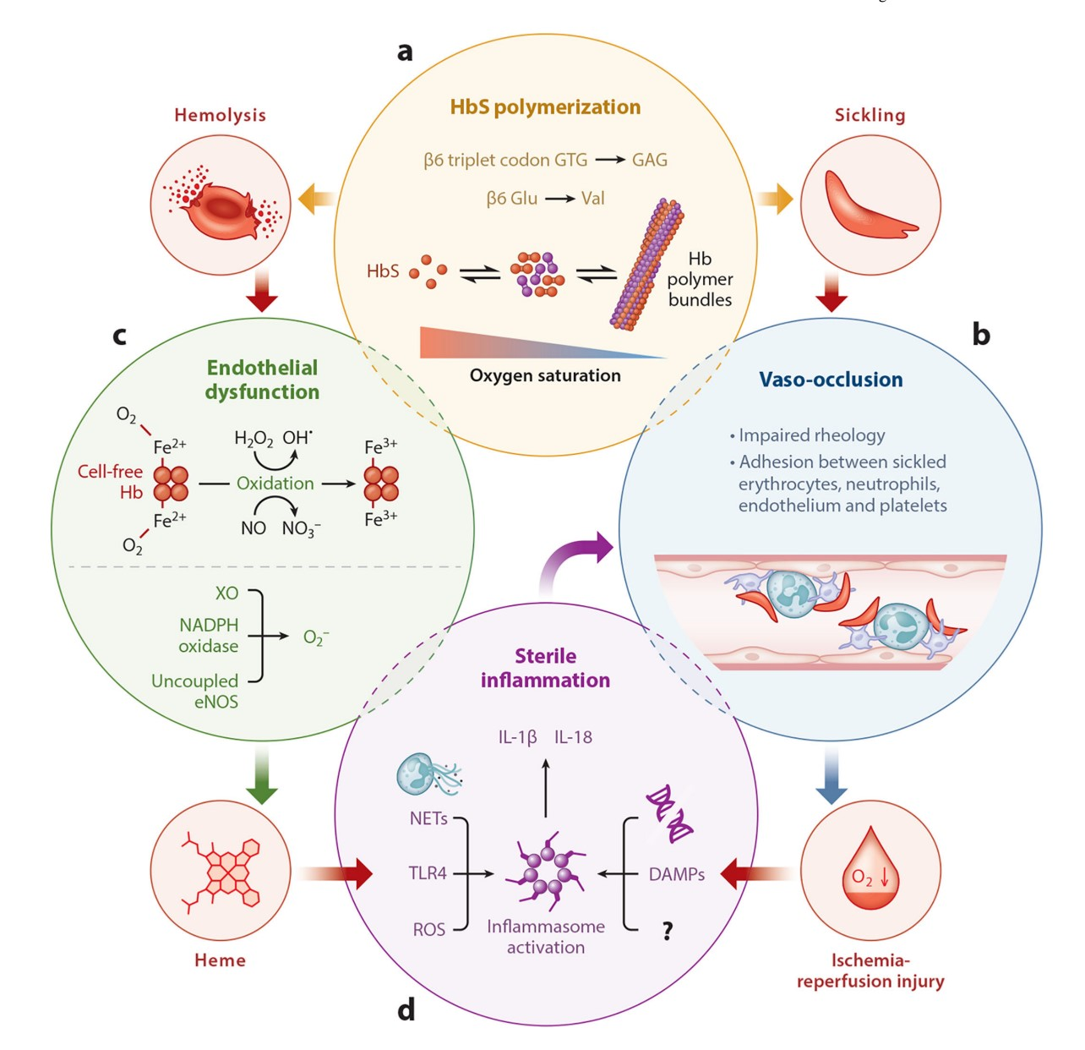
Pathophysiologic Pathways
Sundd P, Gladwin MT, Novelli EM. Pathophysiology of Sickle Cell Disease. Annu Rev Pathol. 2019
Notes:
Figure 1.
Molecular pathophysiology of sickle cell disease. (a) A single-nucleotide polymorphism in the β-globin gene leads to substitution of valine for glutamic acid in the β-globin chain. Following deoxygenation, the mutated hemoglobin (HbS) molecules polymerize to form bundles. The polymer bundles result in erythrocyte sickling (clockwise), which in turn results in (b) impaired rheology of the blood and aggregation of sickle erythrocytes with neutrophils, platelets, and endothelial cells to promote stasis of blood flow, referred to as vaso-occlusion. Vaso-occlusion promotes ischemia-reperfusion (I-R) injury.
Annu Rev Pathol. Author manuscript; available in PMC 2020 March 03.

Slide 25
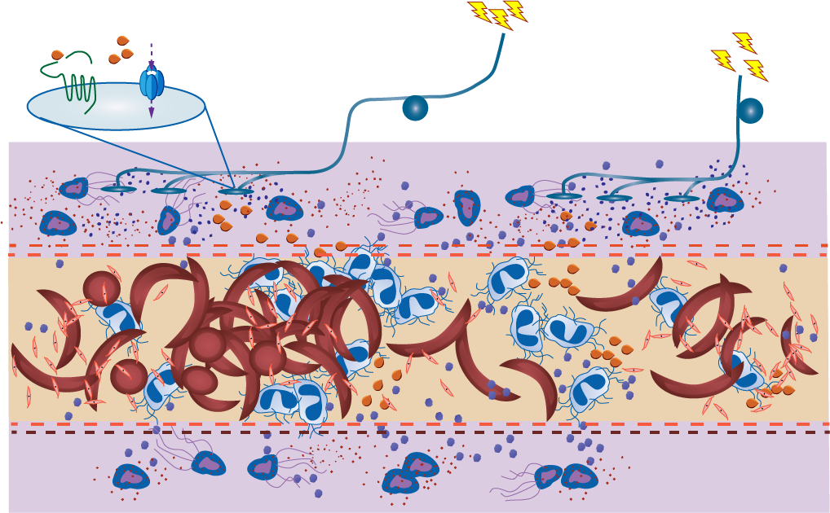








SCD-related Pain Is Due to Complex Interactions Surrounding the Peripheral and Central Nervous Systems
PAIN
Nociceptors
Noxious environment stimulates the primary afferents
Repeated VOCs may cause sensitization leading to an impaired therapeutic response
Recurrent VOCs may lead to a sustained noxious environment,
PAR2
TRPV1
DRG
Ca⁺²
Peripheral
nerve fibers
Vascular permeability
Endothelial activation
Extravascular tissue matrix
Red blood
cells
Neutrophil extracellular
traps (NETs)
Activated mast cells releasing tryptase
Sickled red cells
Mast cells extracellular
traps (MCETs)
Hemolysis-derived
free heme
DRG, dorsal root ganglion; PAR2, protease-activated receptor 2; TRPV1, cation channel subfamily V member
Aich A et al. Curr Opin Hematol. 2019;26(3):131-138.
Platelets
Substance P (SP)
Elastase
25
Notes:
The complex pathobiology of SCD suggests that pain may occur via nociceptive, inflammatory, and neuropathic mechanisms. Each pain state generates its own neurochemical signatures in the periphery and the central nervous system (CNS) and requires different analgesic treatment.
Nociceptors on peripheral nerve terminals are stimulated by the noxious environment
This noxious environment stimulates the primary afferents and second order neurons in the dorsal horn
Repeated VOCs may cause sensitization of peripheral and central nervous system (CNS) neurons, potentially leading to an impaired therapeutic response
Recurrent VOCs may lead to a sustained noxious environment, causing the CNS to be constantly hyperexcitable, leading to transition from acute to chronic pain

Slide 26
The Pain Experience

Slide 27
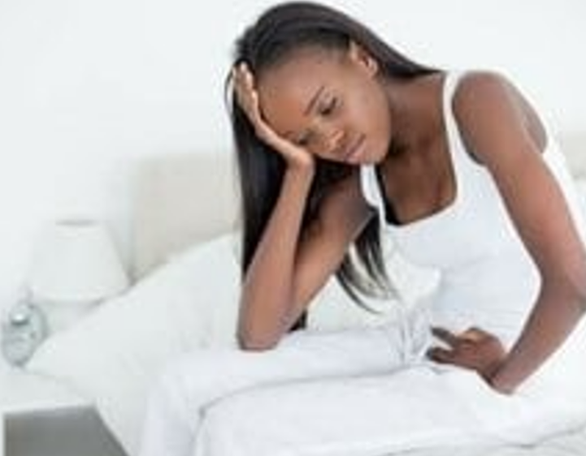
Disparities
Contributing factors
  Stigma related to certain diseases
  Stoicism
  Family oriented, putting self last
  Spirituality
  Communicating pain related to gender and race
  Nutritional deficiencies
Notes:
Racial and ethnic disparities are pervasive in our health care system; pain is no exception. Oligoanalgesia, ineffective treatment of pain, is found at a higher rate in racial and ethnic minorities. Unrelieved pain results in unnecessary suffering, lost days from work and school, delayed healing, functional disability, and increased hospital length of stays. Despite the high prevalence of painful conditions, African Americans are routinely under-treated for their pain.
When patients with SCD have severe pain crisis that results in a visit to the emergency department, they typically have significant wait times for pain control compared to other racial/ethnic groups in the hospital setting. Sickle cell pain can be further exacerbated by stress and perceived injustice. Currently opioids are one of the main tools used to treat pain of SCD. In addition to this, patients with SCD have been heavily impacted by the opioid crisis. In many cases they are not able to get medications with which they had their pain well controlled for years, because physicians have been pressured to decrease the number of opioid prescriptions. Now physicians must follow stringent opioid prescription guidelines that may legitimize the biases that some healthcare providers already have. Patients with SCD are often stigmatized and viewed as drug-seeking, when in fact most do not become addicts. The CDC responded with a formal warning against the misapplication of guidelines in specific patient populations, including SCD. Patients with SCD continue to report high levels of stigma and opioid-phobia in their interactions with health care providers who focus on reducing usage of pain medications without offering viable alternaives.

Slide 28
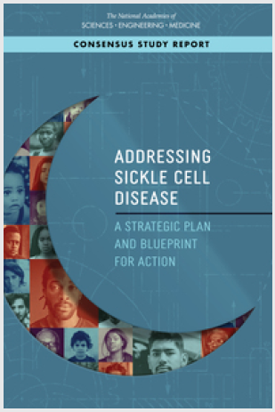
“The health care needs of individuals living with SCD have been neglected by the U.S. and global health care systems, causing them and their families to suffer”
“The SCD community has developed a significant lack of trust in the health care system due to the nearly universal stigma and lack of belief in their reports of pain, a lack of trust that has been further reinforced by historical events, such as the Tuskegee experiment”
NASEM report, 2020
Notes:
To further confirm the disparities that exist, The national academies of science, engineering and medicine published a book titled “Addressing sickle cell disease” A strategic pan and blueprint for action. They determined that many of the problems from the past persist today. The health care needs of individuals living with SCD continue to be neglected by the U.S. and global health care systems, causing them and their families to suffer”
“The SCD community has developed a significant lack of trust in the health care system due to the nearly universal stigma and lack of belief in their reports of pain, a lack of trust that has been further reinforced by historical events, such as the Tuskegee experiment”
The role of race/ethnicity in the context of health care disparities in the US is well-documented. Consideration of SCD as a Black disease in the US has permeated the experience for patients since the first description in the Western medical literature.
The impact is manifested through Structural violence, diagnostic shadowing and weathering.
Structural violence is a phrase that reflects the ways in which society’s structures, systems, and policies affect the wellbeing of individuals and groups in a negative unjust manner.
Diagnostic shadowing refers to the phenomenon in which a physician's diagnostic judgment is influenced by a previously established diagnosis, even in the face of conflicting or ambiguous clinical information. This can lead to confirmation bias, where the physician may selectively focus on information that supports the initial diagnosis and overlook other information that may suggest a different diagnosis. Diagnostic shadowing can have negative implications for patient care, as it can lead to delays in diagnosis or misdiagnosis, resulting in inappropriate treatment and poor outcomes.
Weathering is a term used to describe the physiological and psychological toll that chronic exposure to social and economic stressors can have on individuals, particularly those from marginalized communities who are disproportionately affected by such stressors. This chronic stress can lead to a range of health problems, including cardiovascular disease, diabetes, depression, and premature death. Weathering is an important concept for understanding health disparities and the ways in which structural inequalities can impact individual health outcomes.

Slide 29

Economic disparities in sickle cell disease
Notes:
SCD research has been and continues to be underfunded. It does not receive the research funding and pharmaceutical investment directed at other chronic diseases. For example, CF, which primarily affects non-Hispanic Whites, has fewer than half the number of persons with SCD but received 3.5 times the funding from the NIH and 440 times the funding from national foundations.
For households below the federal poverty line, disease impacts are exacerbated. In addition, SCD perpetuates disparities in health and wealth between Blacks, other minority groups, and non-Hispanic Whites. In an environment where Black Americans disproportionately experience poorer health, educational, and economic outcomes, Black Americans with SCD and their families are left further behind.
Studies have shown that increased poverty is associated with worse health. Socio-economic status is different in families with SCD compared to match families in the same zip code.
Lastly, patients are often told from a young age that they may not reach adulthood. As a results some patients do not prepare for college or adulthood and have reported feeling lost when they reach early adulthood because the did not think they would live that long. This may contribute to putting them further behind educationally and economically.

Slide 30
Acute Pain

Slide 31
VOC Pathophysiology
The increase in inflammatory cells signals the release of cytokines surrounding nociceptor terminals.
This results in a feed-forward mechanism contributing to nociceptor sensitization.
02
04
01
03
Endothelia Cells activate in response to an occlusion releasing cytokines increasing the extravasation of monocytes
The nociceptor is activating and releases substance P or CGRP
Gupta, 2021
Notes:
VOC is Episodic, recurrent, unpredictable. The microvascular obstructions cause impaired oxygen supply leading to an ischemia-reperfusion injury, inflammation, oxidative stress, and endothelia dysfunction.
Acute painful episodes due to VOC and its release of the mediators contribute to the inflammatory milieu triggering Nociceptor activation.
1. Endothelia Cells activate in response to an occlusion releasing cytokines increasing the extravasation of monocytes
2. The increase in inflammatory cells signals the release of cytokines surrounding nociceptor terminals.
3. The nociceptor is activating and releases substance P or (Calcitonin gene related peptide (CGRP).
4. This results in a feed-forward mechanism contributing to nociceptor sensitization.

Slide 32
Chronic Pain
Notes:
Whereas the chronic pain in patients may stem from edema, inflammations, ischemia or nerve damage can be considered as NP pain.
NP pain is 2 types: due to tissue damage following VOC, and the 2nd seems to be consequences of persistent chronic pain.

Slide 33
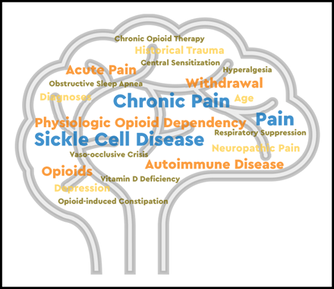

Chronic pain in sickle cell disease
Ifeyinwa Osunkwo,Hazel F. O'Connor,Elna Saah, Optimizing the management of chronic pain in sickle cell disease, Hematology Am Soc Hematol Educ Program, 2020,
Copyright © 2022 American Society of Hematology
Notes:
Figure Legend:
“Chronic pain in sickle cell disease (SCD) refers to pain present on most days lasting over six months. It can start during childhood and the prevalence increases with age. By adulthood, over 55% of patients experience pain on over 50% of days; 29% reporting pain on 95% of days. The true prevalence of chronic pain in SCD is likely underappreciated as it is mostly managed at home. Patients with chronic pain and SCD frequently seek acute care for exacerbation of underlying chronic pain difficult to distinguish from their usual acute vaso-occlusive crises. ”
“Chronic pain in SCD has profound consequences for the patient; is often associated with comorbid psychiatric illnesses (depression and anxiety), not dissimilar from other chronic pain syndromes. They may also experience challenges with sleep hygiene, various somatic symptoms, and chronic fatigue that impair quality of life. How best to treat chronic pain in SCD is not definitively established.”

Slide 34
Targets to treat pain

Slide 35
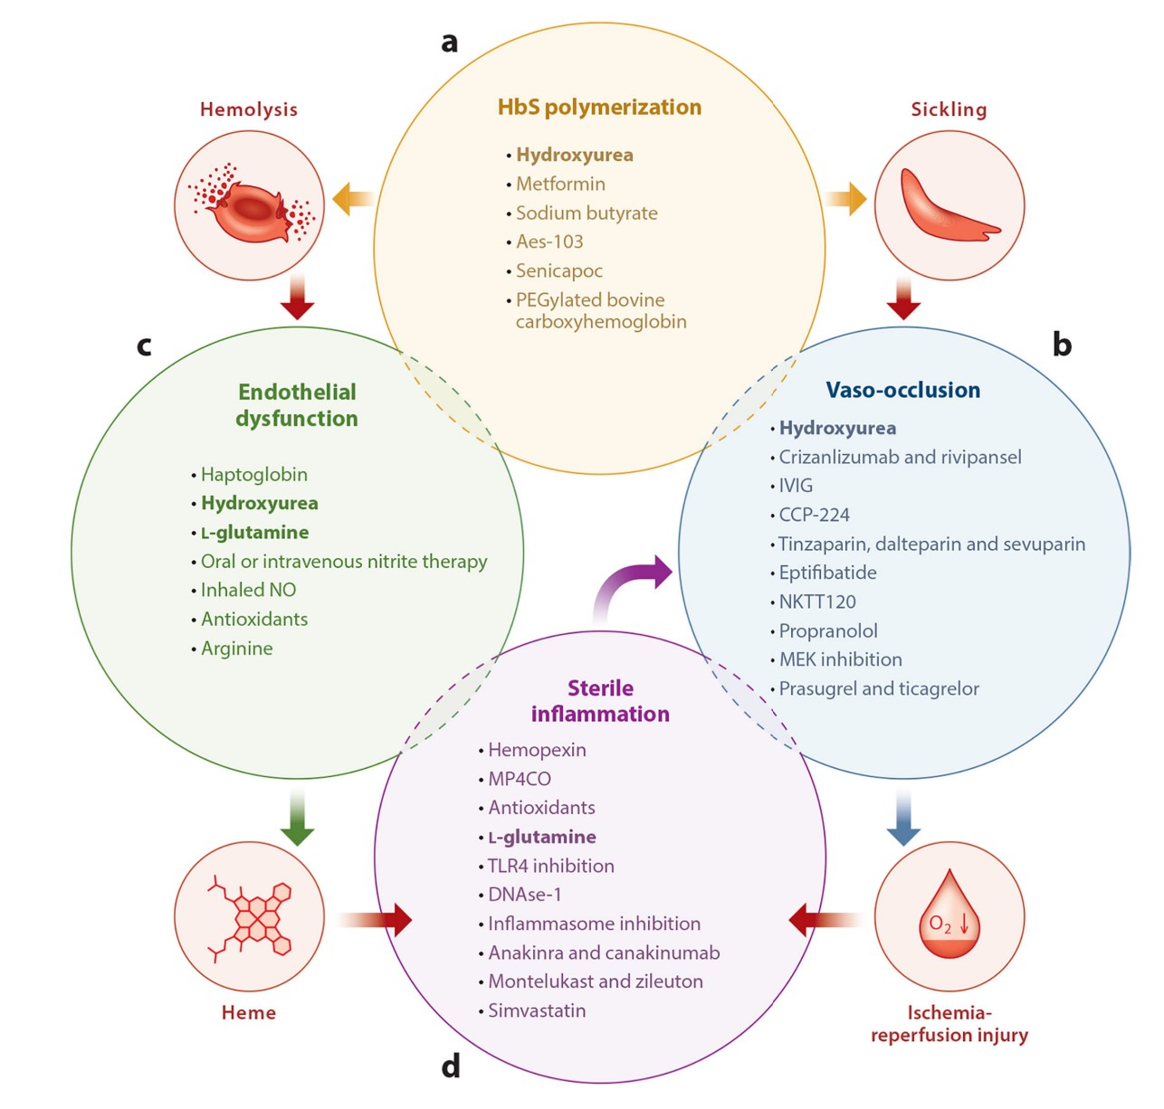
Pathophysiologic Pathways
Sundd P, Gladwin MT, Novelli EM. Pathophysiology of Sickle Cell Disease. Annu Rev Pathol. 2019
Notes:
Figure 2.
Current and future therapies targeting molecular pathobiology of sickle cell disease. (a) Drugs capable of modulating hemoglobin (Hb) polymerization, erythrocyte dehydration, and Hb oxygen affinity. (b) Drugs capable of preventing vaso-occlusion by inhibiting adhesive interactions between leukocytes, platelets, or endothelial cells and erythrocytes. (c) Drugs capable of preventing endothelial dysfunction by scavenging Hb and reactive oxygen species (ROS) or promoting nitric oxide (NO) synthesis. (d) Drugs capable of preventing sterile inflammation by scavenging heme and ROS, digesting neutrophil extracellular traps (NETs), hibiting Toll-like receptor 4 (TLR4) or inflammasome activation, and inhibiting IL-1βdependent innate immune signaling. Drugs approved by the US Food and Drug Administration (hydroxyurea and L-glutamine) are shown in bold font.

Slide 36
Pain Research in SCD
Notes:
Sickle cell disease id different from other pain conditions and require disease specific strategies to treat the pain.

Slide 37
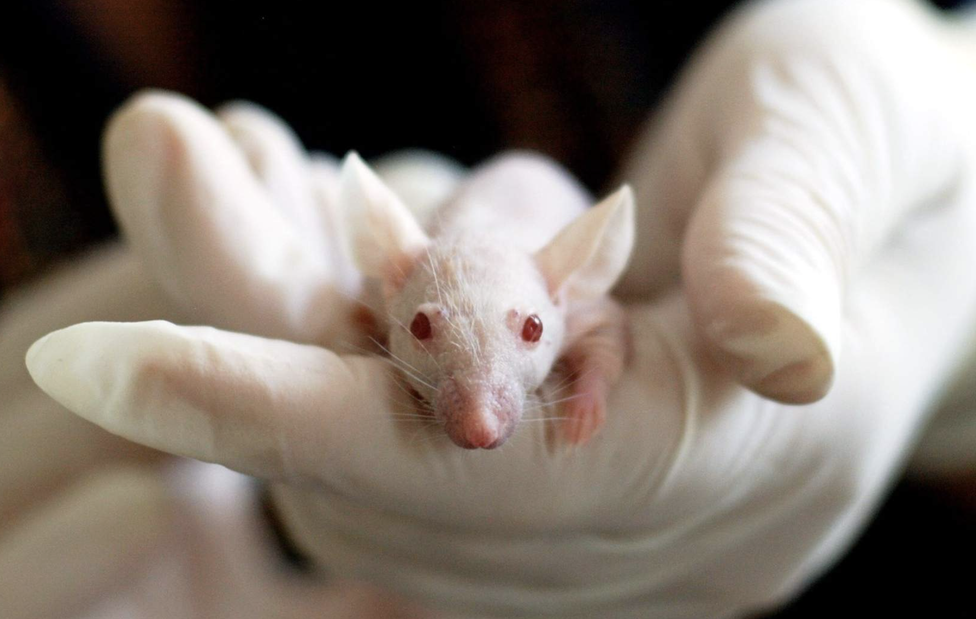
Animal Models
Transgenic humanized mouse models by “knocking out” mouse globin genes
  HbSS-BERK
  HbSS-Townes
Mimic severe type of SCD and associated symptoms including VOC
Studies found similarities in mechanical, thermal, electrical sensory testing.
Notes:
In both Berkley (HBSS-BERK) and Townes (HBSS),the mouse α- and β-globin alleles have been knocked down, and human α- and human sickle β-globin alleles have been inserted.
Wang et. al., reported findings that these mice demonstrated neuropathic pain within 3 weeks of birth.
Both SCD mice display many of the pathophysiological changes observed in SCD patients including anemia, organ damage, hypoxia-induced cell sickling, and pain sensitivity.
Similar findings for clinical studies using QST found that patients with SCD report significant thermal hyperalgesia and cool/cold allodynia compared to matched controls.

Slide 38
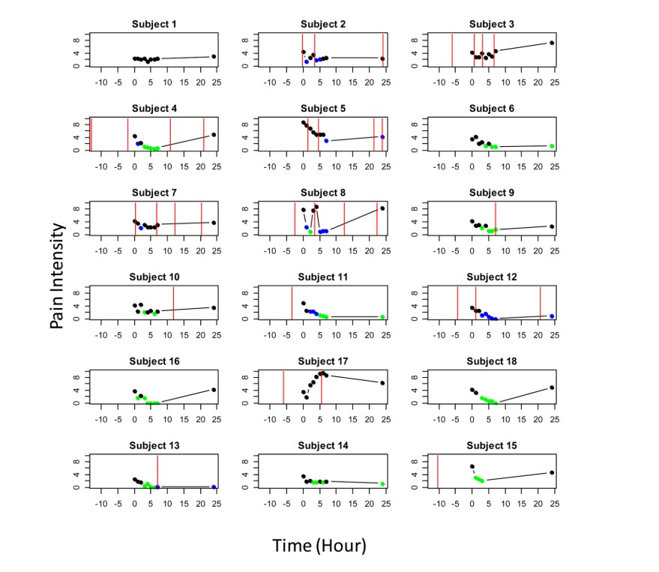
SCD Variabilities
Clinical and symptoms variations within subject overtime and between subjects
Mechanism-driven phase I translational study of trifluoperazine in adults with sickle cell disease.
R. E. Molokie, D. J. Wilkie, Z.J. Wang, et.al., Eur J Pharmacol. 2014 January 15
Notes:
While examining neuropathic pain in SCD it became clear that adjuvant analgesic treatments should be explored. Since pain in SCD can be neuropathic in origin, anticonvulsant and antidepressant medications, which are established therapies for neuropathic pain, are being explored in SCD. (Gupta 2021)
Ca2+/calmodulin-dependent protein kinase II (CaMKII) is multifunctional protein kinase that is a key component of calcium signaling pathways. CaMKII-alpha has been implicated in chronic inflammatory pain and neuropathic pain. CaMKII-alpha has been shown play a critical role in OIH (Molokie 2010, Gupta 2021).
Ca2+/calmodulin protein kinase IIα (CaMKIIα) has a known role in neuropathic pain and trifluoperazine is a potent CaMKIIα inhibitor. Researchers studied trifluoperazine in adults with SCD: (1) the adverse effects and (2) pain intensity reduction. Patients received a single dose each. The researchers measured (1) adverse effects, (2) pain intensity, and (3) supplemental opioid analgesics. The doses ranged from 0.5 – 10mg. Participants reported moderate to severe sedative effects at the higher doses. Eight subjects reported 50% reduction in chronic pain without severe sedation or supplemental opioid analgesics; one of these subjects had dystonia 24.5 hrs after the 10 mg dose. The analgesic effect lasted for at least 24 hrs in 3 subjects. Sedation resolved with caffeine and dystonia resolved with diphenhydramine.
This figure represents Visual Analogue Scores by Subject (1-18) during the 24-hour Study. The dose appears in order of administration: 0.5 mg for subjects 1-3, 1mg for subjects 4-6, 2 mg for subjects 7-9, 5 mg for subjects 10-12, 7,5 mg for subjects 16-18, and 10 mg for subjects 13-15. The green symbols represent 50% reduction from baseline (hr 0), blue symbols represent 50% from baseline but contaminated by a supplemental analgesic, which is represented by red vertical lines.
In mice with OIH, CaMKII activity was correlated with mechanical allodynia and thermal hyperalgesia. This drug may have both beneficial and harmful effects and requires further study because the CaMKIIα knockout mice did not survive the treatment. Studies examining long-term adverse and analgesic effects are ongoing.
There was one participant who had 38 acute care utilization events in one year and actually spent 180 days in the hospital. This participant got the best benefit from the trifluoperazine dose (?mg).
This is therapy based upon a molecular evidence and was carried back and forth between the lab and the and the bedside. Trifluoperazine is expected be most effective in chronic, but NOT ACUTE, types of SCD pain.

Slide 39
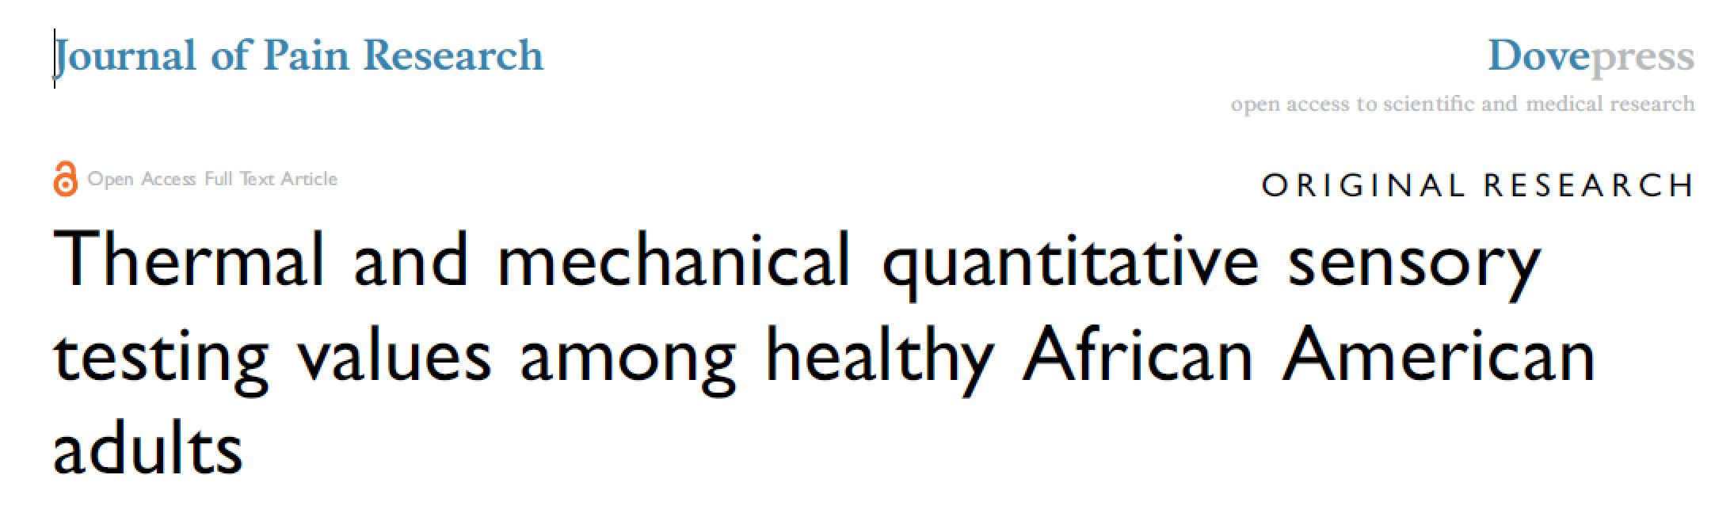
Powell-Roach, K. L. et., al., Journal of Pain Research 2019:12 2511–2527
Notes:
Studies of quantitative sensory testing (QST) in sickle cell disease (SCD) showed that adequate reference values for patients’ commonly reported pain sites are unavailable from healthy pain free African Americans, which limits interpretation of results.
Aim: The study purpose was to characterize QST values in healthy, pain-free African American adults and older adults whose prior pain experiences and psychological status were also measured.
We examined the QST values for differences by sex, age group (younger and older adults), and body test site.

Slide 40
Mean Thermal and Mechanical Threshold
Powell-Roach, K. L. et., al., Journal of Pain Research 2019:12 2511–2527
Notes:
The temperature of adaptation for this study was 32 °C. Participants reported warm (pink bar) and cool (blue bar) detection at levels similar to those published in other populations. Average heat pain threshold (orange bar) was 37.8°C, And average cold pain threshold (green bar) was 26.3°C. And that pain was rated on average 2/10, in contrast to other studies where the values were 43-45 degrees for heat pain and 10 degrees for cold pain that was rated on average 6/10. The average mechanical pain threshold was 16.7 gF.
There were no significant differences in pain thresholds by sex or by age.
Overall, this large sample of healthy African American adults had average thermal pain thresholds within 6 °C of the temperature of adaptation that were not significantly different by age or sex, but lower than those in other published reports. Differences in responses to thermal and mechanical stimuli for upper versus lower body sites were consistent with previous research. We believe, these results can be used as controls for African Americans with SCD and tested with the same protocol. Additional research is needed to resolve differences in QST values observed with different protocols and to establish normative QST values for healthy, pain-free African Americans with consideration of geographic region within the US and genetic admixtures of the participants.
Some of the results may be attributed to the instructions provided to the patient, “Call your pain a number”.
In another published study, the QST values were used to compare thermal thresholds in patients with sickle cell disease. Patients with SCD had even lower thresholds to mechanical stimuli and reported higher pain intensity scores to all thermal and mechanical stimuli at non-painful body sites; twice as many patients showed sensitization at the anterior forearm, and 18% exhibited some element of central sensitization. This means they showed persistent allodynia (stimulus not damaging to tissue is painful) and hyperalgesia (tissue damaging stimulus is more painful than usual), which may indicate neuropathic pain and could contribute to a paradigm shift in the treatment of SCD pain.

Slide 41
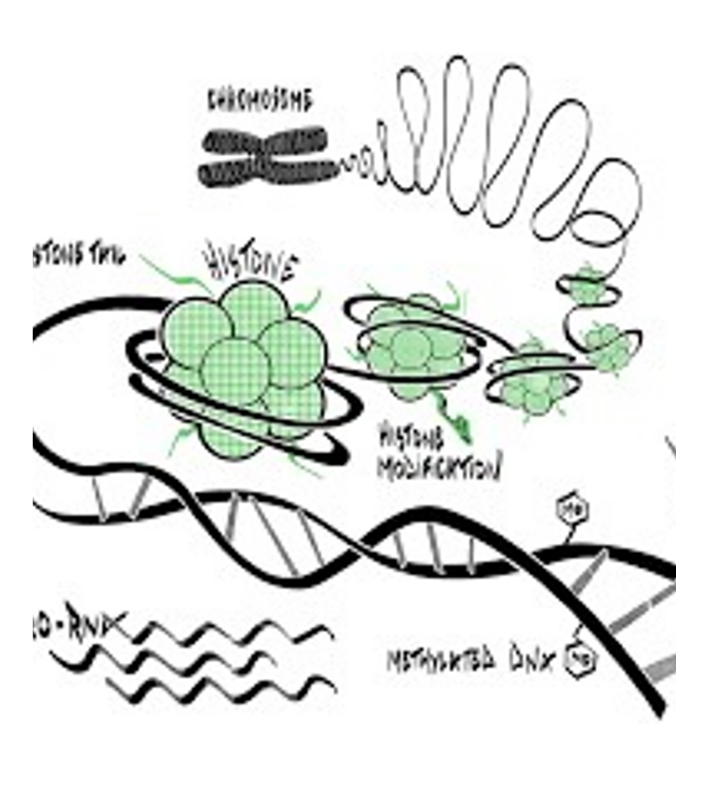
Genetics in sickle cell pain
Genetic variability is suspected to have a role in the perception of pain.
Metabolism from alterations in pathways.
Genetic markers may lead to a better understanding of pain
Notes:
Genetic variability is suspected to have a role in the perception of pain. For example, some of these variations affect metabolism of medications which may result from alterations in pathways. Because of this potential variability, approaches to gain a better understanding of pain may be found by exploring genetic markers, such as single nucleotide polymorphisms (SNPs). A SNP is a single base pair substitution that may result in changes in the downstream sequence, protein expression, or phenotypic changes in appearance, disease risk, and response to drugs or the environment. For example, a larger number of patients with SCD have a cytochrome P450 2D6 polymorphism that decreases the conversion of codeine to morphine resulting in decreased analgesia.

Slide 42
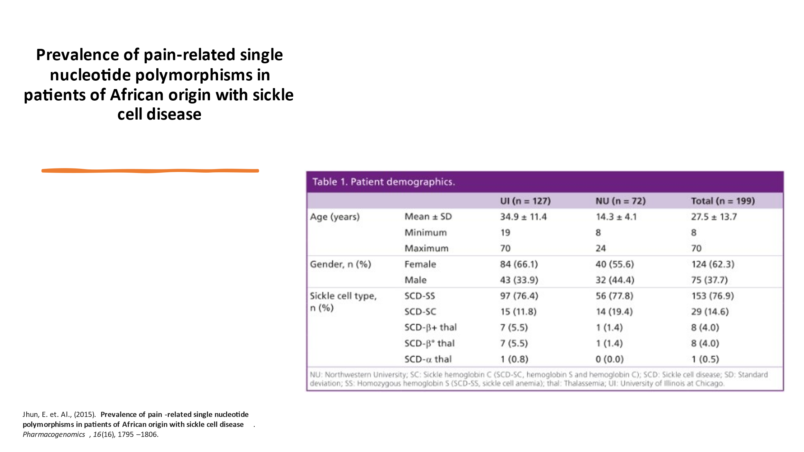
Variable Pain
Notes:
Our group prioritized and examined the genotype and allele frequencies of 115 SNPs from 49 candidate pain genes in 199 adult African– Americans and pediatric patients of African origin with SCD. Analyses were performed and compared with available data from public databases.
Results: Genotype and allele frequencies of a number of SNPs were found to be different between our cohort and those from the databases and between adult and pediatric subjects.
Discussion: We found that genotype and/or allele frequencies for a number of SNPs were statistically different between our SCD cohort and literature data for African–Americans and also between our UI sample primarily African American and NU sample primarily of West African (Nigerian) origin.

Slide 43
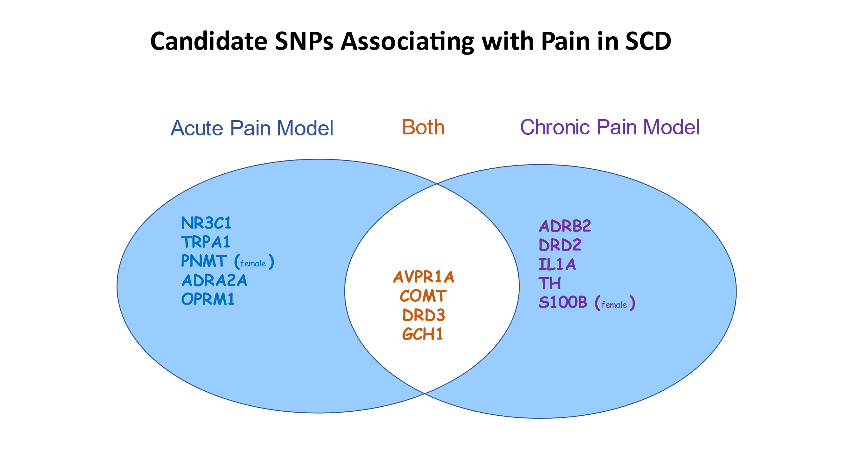
Notes:
We reported on patients with SCD who participated in a study of the associations between genetics and pain phenotypes. We choose the rs10877969 AVPR1A (Arginine Vasopressin) (Single nucleotide polymorphism – a.k.a. SNP) rs10877969 because its relationship to and my interest in PAIN and its relationship to STRESS. We postulated that AVPR1A polymorphisms might help to explain some of the clinical observations in SCD pain, especially since in patients with SCD, clinical factors such as pain and stress have been associated with increased health care utilization, but it is not known if the presence of the AVPR1A SNP plays a role in this observation.

Slide 44
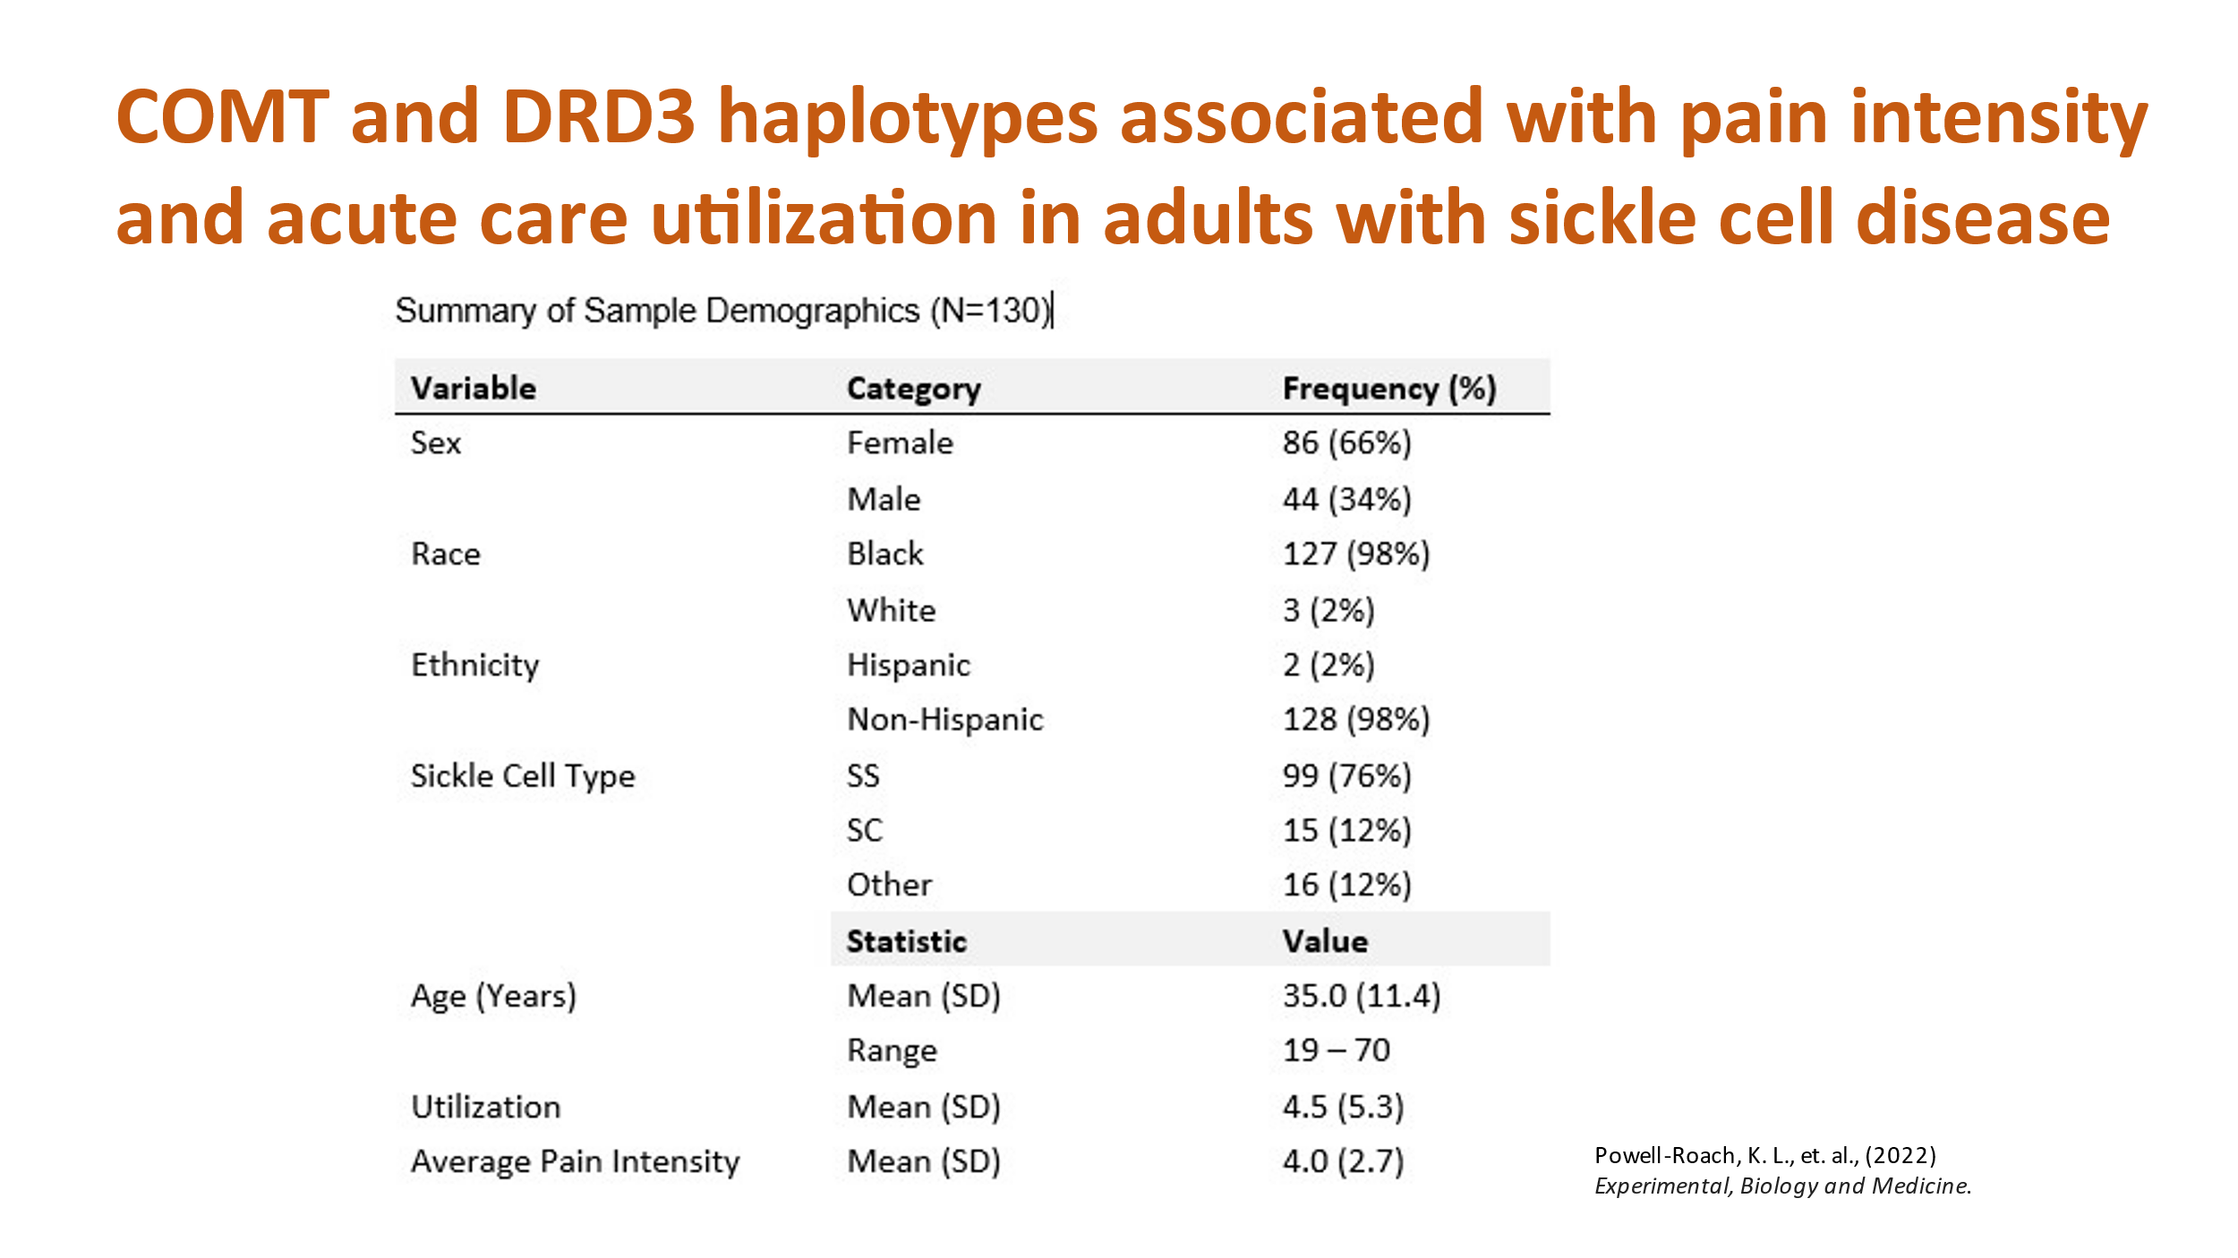
Notes:
Purpose: A previous, exploratory analysis of a COMT gene single nucleotide polymorphism (SNP) and a DRD3 SNP by our group suggested possible contributions to pain-related acute care utilization in people with sickle cell disease (SCD). Our aim was to extend the analysis to gene spanning haplotypes of COMT SNPs and DRD3 SNPs, to investigate possible associations with pain intensity and pain-related acute care utilization in a SCD cohort.
Patients and methods: Genotyping was conducted, and clinical data were collected, including self-reported pain intensity using PAINReportIt® (average of current pain and least and worst in past 24 hours, API) and medical-record extracted pain-related, acute care utilization data of 130 adults with SCD.
Findings: We found COMT and DRD3 haplotypes associated with pain-related SCD features, suggesting that in future studies more emphasis be placed on cis effects of SNP alleles in evaluating genetic contributions to SCD pain and acute care utilization for pain.

Slide 45
Current and Emerging Therapies
Transfusion
L-Glutamine (Endari)
Hydroxyurea
2017 - ≥ 5 years, all genotypes
1998 – Adults
2017 – Children >2 years, based on Escort-HU study, which included 1047 patients with sickle cell anemia (495 children).
Arginine
Crizanlizumab (Adkveo)
Sleep
2019 - ≥ 16 years, all genotypes
Voxelotor (Oxbryta)
Cannabinoids
2019 - ≥ 12 years, all genotypes
Notes:
With the exception of the stem cell transplant, which is curative, the treatment for sickle cell crisis had not changed in many years. Until recently, the treatment consisted of oxygen, intravenous fluids, hydroxyurea, antibiotics, and pain medications. Within the past 5 years three different drugs have been approved by the FDA for the treatment of sickle cell disease, particularly to reduce VOC. Other emerging therapies are listed here:
Transfusion
Increases oxygen carrying capacity of blood
Risks of alloimmunization, transfusion reactions, iron overload, viral infections
Hydroxyurea
Resulted in an increase in hemoglobin F. The percentage of patients with at least one vaso-occlusive episode, one episode of acute chest syndrome, one hospitalization due to SCD or one blood transfusion decreased after 12 months of hydroxyurea treatment.
L-Glutamine
The mechanism of action of the amino acid L-glutamine in treating SCD is not fully understood. L-glutamine, is presumed to work by reducing oxidative stress and endothelial adhesion of RBCs.
Voxeletor functions by binding hemoglobin and shifting the oxygen dissociation curve to inhibit deoxygenation and sickling. It has been shown to decreased hemolysis and improved anemia.
Crizanlizumab is a humanized monoclonal antibody directed against P-selectin that showed effectiveness in preventing VOC induced pain crises.
Arginine supplementation was shown to enhance nitric oxide bioavailability and decrease hemolysis and oxidative stress in sickle mice. In a placebo controlled randomized controlled trial (RCT) performed in Nigeria showed a significant reduction in time to VOC resolution, length of hospital stay, and total analgesic requirements. As a result, arginine may be a relatively inexpensive treatment for treating pain crises in SCD. (Gupta 2021)
Cannabinoids are known to have both analgesic and anti-inflammatory effects, and may ameliorate mast cell activation, leukocyte trafficking and adhesion, neurogenic inflammation, oxidative stress, endothelial activation, and hyperalgesia via cannabinoid receptors 1 (CB1R) and 2 (CB2R). (Gupta 2021). Cannabinoids show promise as a potential therapeutic for SCD, but more clinical studies are needed regarding their efficacy. While they show promise as pain management therapeutics, their use remain controversial.
Sleep The prevalence of sleep disturbance in adults with SCD has been reported to be near 70%. In a previous study of patients with SCD, it was found that subjective parameters of sleep including duration, fragmentation, and efficiency could be used to predict clinical pain (Gupta, 2021). Recent studies have shown a link between sleep, vasoconstriction, and pain. Given this therapeutic approaches aimed at optimizing sleep may be helpful in treating pain.

Slide 46
Strategies to Prevent and/or Treat Pain

Slide 47
Translation to improve SCD outcomes
Environment
Food supplements
Diet and pleasure, emotional well-being may be helpful in ameliorating pain, reducing opioid requirement and improving survival in SCD
PEA, curcumin, CoQ10 can have disease modifying and/or anti-nociceptive effect.
OMICS
Translation
To determine and validate gene/protein/metabolon signatures specific to individual comorbidities in persons with SCD and correlation with environmental and dietary factors.
Bench to bedside for biomarkers of pain and prevention/treatment of pain (transcranial focused ultrasound, targeting of proteases, cannabinoids including CBD, and integrative approaches – CBT, acupuncture, hypnosis, etc).
Notes:
Environment: Diet and pleasure, emotional well-being may be helpful in ameliorating pain, reducing opioid requirement and improving survival in SCD. Early and pre-natal dietary interventions can improve SCD pathobiology and survival (Jahagirdar et al., Haematologica 2019)
Food supplements: PEA, curcumin (Valverde et al., Haematologica 2016), CoQ10 can have disease modifying and/or anti-nociceptive effect.
OMICS: To determine and validate gene/protein/metabolon signatures specific to individual comorbidities in persons with SCD and correlation with environmental and dietary factors.
Translation: Bench to bedside for biomarkers of pain and prevention/treatment of pain (transcranial focused ultrasound, targeting of proteases, cannabinoids including CBD, and integrative approaches – CBT, acupuncture, hypnosis, etc).

Slide 48
Strategies for
Future Studies

Slide 49
Suggestions For Future Studies
Identifying biomarkers for pain in SCD has been identified as a high research priority
QST – may have been underestimating the sensitivity un the African American population. Norms from the literature were in adequate.
Needs cohesive measures and procedures
Listen to the patients and allow them to feed the paradigm.
Notes:
QST – may have been underestimating the sensitivity un the African American population. Norms from the literature were in adequate.
Listen to the patients and allow them to feed the paradigm.
In ASH’s recently published consensus recommendations on clinical trial endpoints, the identification of novel biomarkers for pain in SCD was identified as a high research priority. Including leukocytes and their inflammatory markers.

Slide 50
Can the environment influence pain?
Diet/nutrition
Company
Social isolation
Loneliness
Stigma
Sleep
Pleasure
Trauma
Depression
Anxiety
Food supplements

Slide 51
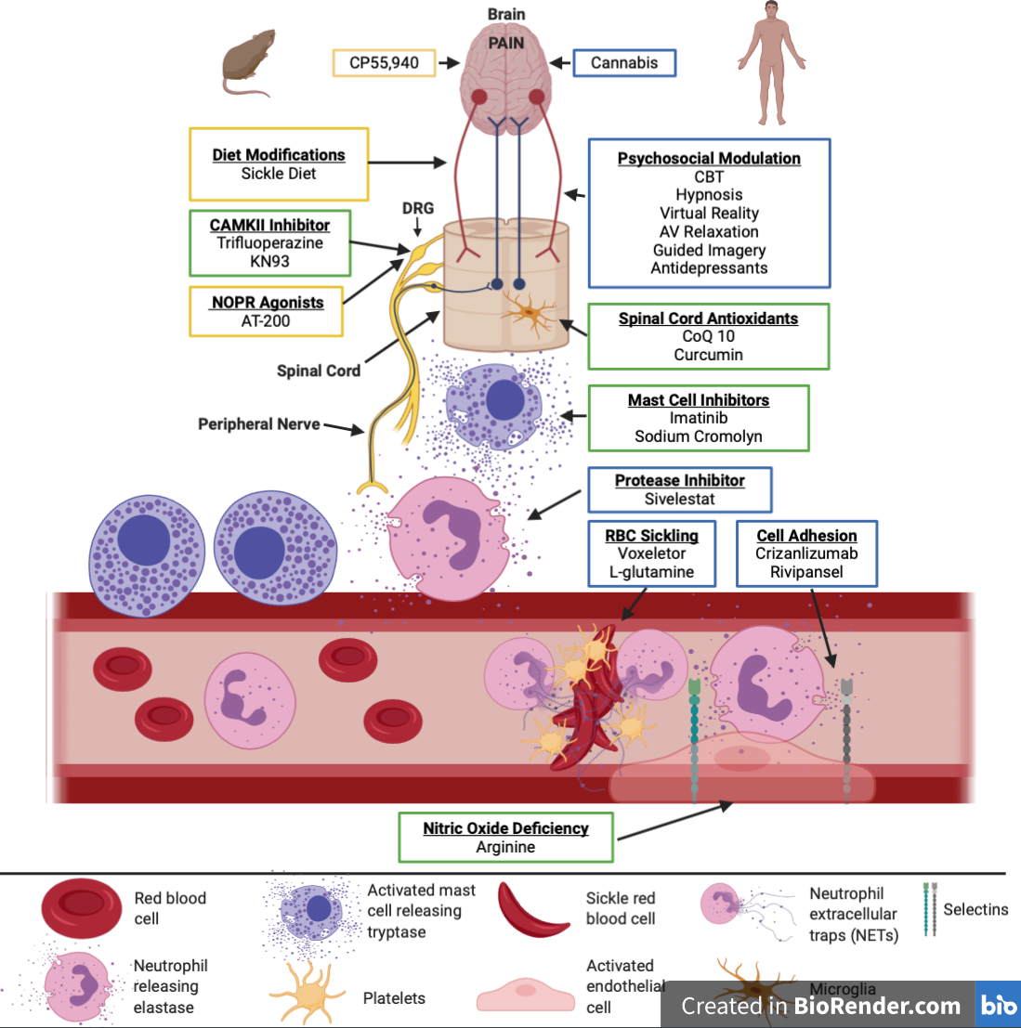
Targeting peripheral and central mechanisms of SCD (Disease modifying and/or anti-nociceptive effect)
Sagi et al., Transl Res 2021
Notes:
Now that you have an understanding of the pathophysiology and treatment strategies in sickle cell disease, this slide is a representation of how it all comes together in HUMAN and in Mouse models
This overview includes recently approved therapies and those in development for treating pain in sickle cell disease.
Different treatment strategies are being employed including those which target sickle red blood cell pathology, sensory nerve transmission, and top-down mechanisms of pain. Treatments studied primarily in humans are outlined in blue, whereas those studied primarily in mice are outlined in yellow. For therapies in which both mice and human studies were performed, a green outline is used. AV, Audio-visual relaxation; CaMKII, Ca2+/calmodulin-dependent protein kinase II; CBT, cognitive behavioral therapy; CoQ10, Coenzyme Q10. NOPR, Nociception opioid receptor.

Slide 52
THANK YOU

Slide 53
Questions?

Slide 54

Contact Information
Keesha L (Powell) Roach, PhD, RN
University of Tennessee Health science Center
Assistant Professor
kroach10@uthsc.edu
(312) 952-1317
Pubmed
https://www.ncbi.nlm.nih.gov/sites/myncbi/keesha.roach.1/bibliography/54291144/public/?sort=date&direction=ascending

Slide 55
Prevent pain at its source from being evoked
Target the disease process that evokes the nervous system to transmit pain
2. Disease modifying strategies (disease specific)
Through the induction of HbF; RBC hydration; target leukocytes, cytokines, and inflammatory markers
Hydroxyurea, Sanguinate, anti-sickling agents, antioxidant therapy,
3. Treat pain once it is evoked
Target the nociceptive mechanisms
Analgesics: Opioids, NSAIDs, Integrative approaches
4. Perception modulation
Target the brain and top-down spinothalamic system
Mind-body, CBT, hypnosis, virtual reality, environment
Notes:
Targets to teat pain con’t

Slide 56
My Proteomics Findings
Awaiting opt put and analysis
Notes:
QST – may have been underestimating the sensitivity un the African American population. Norms from the literature were in adequate.
Listen to the patients and allow them to feed the paradigm.
In ASH’s recently published consensus recommendations on clinical trial endpoints, the identification of novel biomarkers for pain in SCD was identified as a high research priority. Including leukocytes and their inflammatory markers.

Slide 57
SCD MORTALITY – IN THE U.S.
SCD-related death among Black or African-American children <4 years of age fell by 42% from 1999 through 2002.
Coincided with the introduction the 7-valent pneumococcal conjugate vaccine (PCV-7) in 2000.

Slide 58
In Memoriam
Notes:
In the past year we have lost many pioneers who devotedly represented the and defended those challenged with sickle cell disease.

Slide 59

In Memoriam
Hertz Nazaire
1973-2021
Hertz was a renowned artist and author who used his painting skills to raise awareness for sickle cell disease. He was also well-known for his SCD advocacy work.

Slide 60

In Memoriam
Carlton Haywood, Jr.
1976-2021
Carlton was a lifelong champion of improving the lives for people living with sickle cell disease. He sought to explore, call attention to, and resolve the issues that inhibited effective sickle cell disease care and research — to help those suffering from now and in the future.

Slide 61

In Memoriam
Kwaku Ohene-Frempong
1946-2022
Dr. Ohene-Frempong, a leading pediatric sickle cell physician, was a true leader in the sickle cell community and dedicated his life and career to working with SCD. He held many roles on the Sickle Cell Disease Association of America board of directors over the years, including chief medical officer, board chair and board member emeritus. He also sat on the SCDAA Medical and Research Advisory Committee.

Slide 62

In Memoriam
Samir Ballas
1938-2022
Dr. Ballas, physician and sickle cell research researcher, was a true leader. He had a lifelong commitment to caring for adults living with sickle cell.

